Slide 1
Enrollment Review
George Zimmerman
Executive Director of Admissions and Recruitment

Slide 2
National Landscape

Slide 3
National Landscape

Slide 4
National Landscape

Slide 5
National Landscape

Slide 6
New Strategies
Realign marketing and recruitment to better support efforts
Improve data analytics and the way we track students through the process
Increased collaboration with divisional campuses and departments in Morgantown to support One WVU recruitment

Slide 7
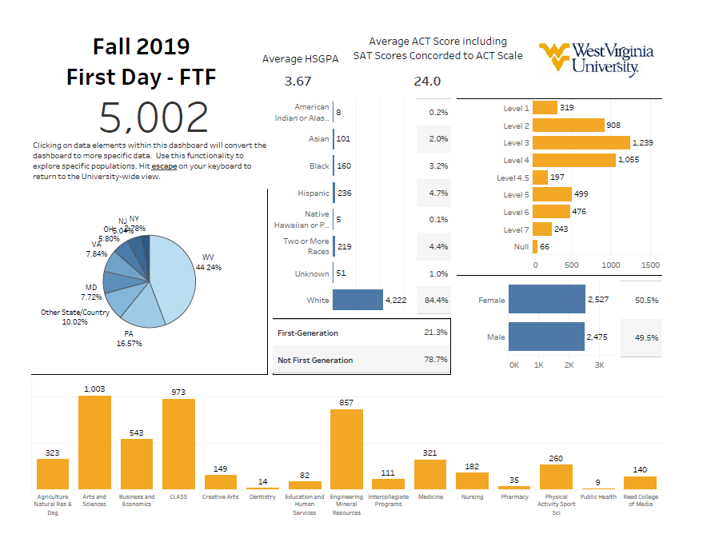

Slide 8
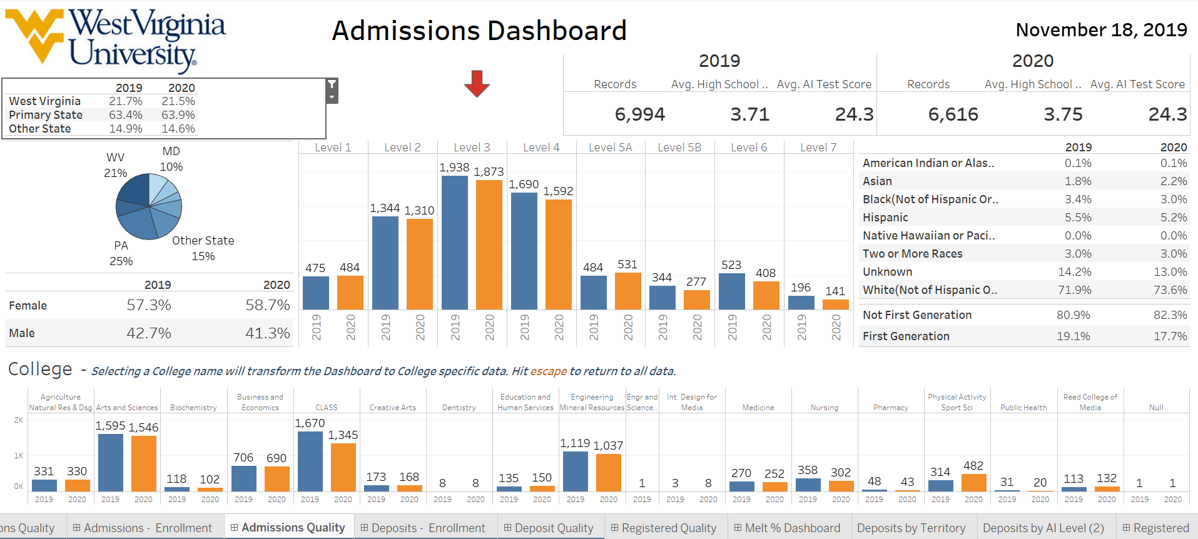

Slide 9
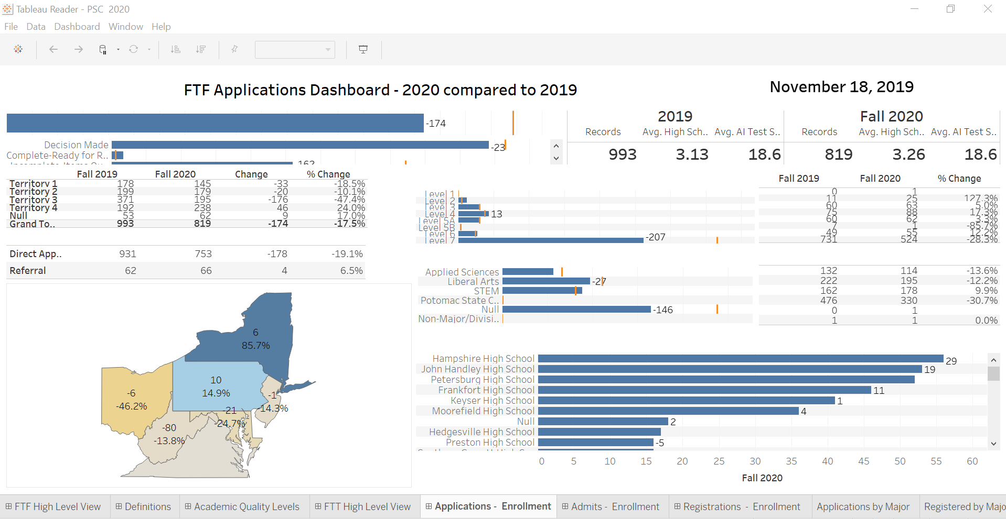

Slide 10
New Strategies
Rethought the funnel to better utilize marketing and recruitment initiatives
Created two stages where we engage with students. Leads and Admits
Targeted messages can live within those stages but core messages remain consistent. Academics, res life, value propositions, etc

Slide 11
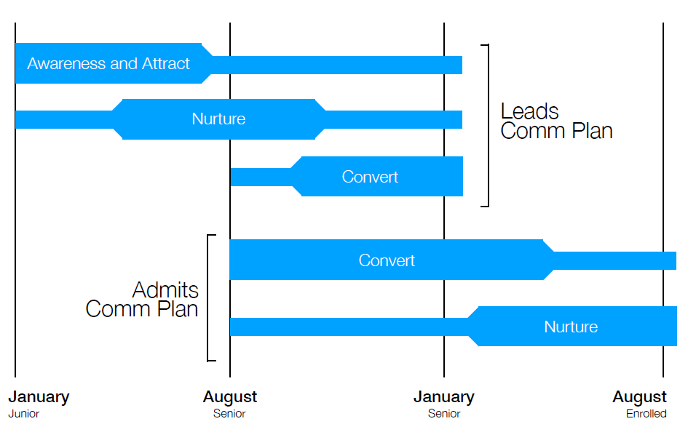

Slide 12
Student Mindsets
Mindsets help to target student messaging based on what resonates with that student
National research of prospective and admitted students show how students with different mindsets conduct a college search
Analysis of WVU’s applicant pool can help guide marketing messages and delivery based on the predominate student mindset

Slide 13
Student Mindsets

Slide 14
Marketing to Support Recruitment
Divided the country into 15 regions based on current recruitment resources and potential new markets
Identified areas of interest within those regions to tie academic offerings to outcomes using census and job data
Developing marketing plans that showcase WVU as an option to gain an education that will tie to these outcomes focused

Slide 16
Pathway Admissions
Instituted the use of Pathways into Fall 2020, Fall 2021, and Fall 2022 recruitment plans
Beginning in Fall 2021 will admit students in Pathways instead of “pre” majors
Pathways illustrate how majors parallel each other and the breadth of choices WVU has to offer
Encourages exploration as well as shows students outcomes based on related interests

Slide 20
Questions?

