Slide 1
Office of Student Conduct Overview

Slide 2
Campus Student Code
What is it?
establishes written rules, regulations, and procedures concerning student conduct and discipline for the main campus of West Virginia University
Authority given by the Board of Governors
This code applies to all students associated with the main campus of West Virginia University under the authority of the West Virginia University Board of Governors.

Slide 3
Jurisdiction
on University premises
at University sponsored activities
conduct that does not occur on University premises but adversely affects or interferes with the educational or orderly operation of the University, its mission, or the pursuit of its objectives
conduct that does not occur on University premises but, in light of all of the facts and circumstances, would endanger the health, safety, or property of the University, the University Community, or its neighboring communities
conduct that occurs on or off of University premises or property which violates federal, state, or local laws, policies of the West Virginia University Board of Governors, institutional or campus rules or regulations, directives of University officials, including failing to observe standards of conduct which are appropriate for an academic institution.

Slide 4
Types of Cases
Individual
Student Organization
Title IX
Academic Misconduct
Conflict Resolution

Slide 5
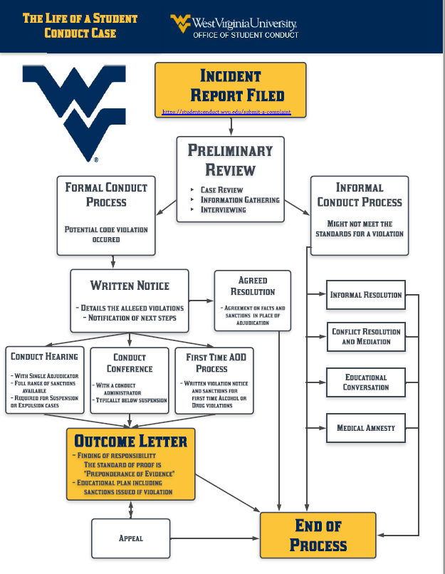
Process
Notice
Opportunity to be heard
Resolution Options
Appeal

Slide 6
Standard of Evidence
Preponderance
More likely than not
50% plus a feather
Something must tip the scales in one direction or the other

Slide 7
Disciplinary Records
Finding of Responsibility constitute disclosable disciplinary record
FERPA Guidelines
Employers, graduate schools, study abroad, etc…
Record Retention
7 years unless suspension or expulsion

Slide 8
Student Rights
Notice: To know what violations you are alleged to have committed
Opportunity to Respond: To have a meeting to share your perspective about what occurred or remain silent
Advisor: serve as a support person throughout the process (at discretion of adjudicator)

Slide 9
Student Rights (continued)
Attorney: Actively represent you in cases where suspension or expulsion could result.
Notice of Outcome: written notification of decision detailing the rationale.
More due process rights when facing suspension/expulsion.

Slide 10
Procedure for complaints of Complaints or Reports of Discrimination, Harassment, Sexual & Domestic Misconduct, Stalking, and Retaliation.
Sanctions in Title IX Cases go into effect immediately
Both parties can file appeals in Title IX cases
Both parties may have advisors and/or attorneys

Slide 11
Alcohol and Other Drug Amnesty
(1) Remains with the person who reasonably appears to be in need of emergency medical assistance due to an overdose until such assistance is provided;
(2) Identifies himself or herself, if requested by emergency medical assistance personnel, law-enforcement officers, or University officials;
(3) Cooperates with and provides any relevant information requested by emergency medical assistance personnel, law-enforcement officers, or University officials needed to treat the person reasonably believed to be experiencing an overdose; and
(4) Completes any additional conditions imposed on the student or student organization by the Student Code Administrator.

Slide 12
Submitting a Complaint
http://studentconduct.wvu.edu/submit-a-complaint

Slide 13
QUESTIONS?
Office of Student Conduct

Slide 14
Carrie Showalter Exec. Director, Office of Student Conduct Location: 87 Boreman North Phone: 304.293.8111 Web: https://studentconduct.wvu.edu

