Slide 1
NSSE results
Impact value in Student Life

Slide 2
What is NSSE- National Survey of Student Engagement
NSSE annually collects information at hundreds of four-year colleges and universities about student participation in activities and programs that promote their learning and personal development.
NSSE surveys first-year and senior students to assess their levels of engagement and related information about their experience at your institution.
The results provide an estimate of how undergraduates spend their time.
Institutions use their data to identify aspects of the undergraduate experience that can be improved through changes in policy and practice.

Slide 3
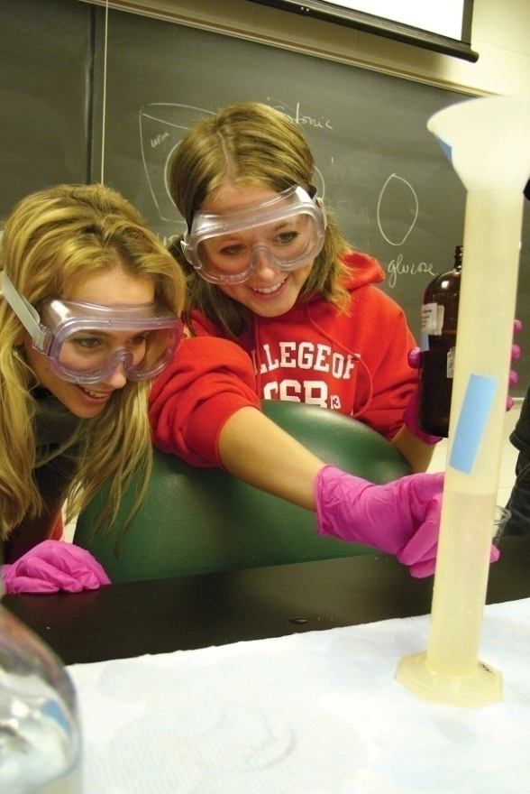
Goals of NSSE Project
Focus conversations on undergraduate quality
Enhance institutional practice and improvement initiatives
Foster comparative and consortium activity
Provide systematic national data on “effective educational practices”

Slide 4
What is student engagement?
What students do – Time and energy devoted to studies and other educationally purposeful activities
What institutions do – Using resources and effective educational practices to induce students to do the right things
Educationally effective institutions channel student energy toward the right activities

Slide 5
Supporting Literature
Traces the development of student engagement as a research-informed intervention to shift the discourse on quality in higher education to emphasize matters of teaching and learning while providing colleges and universities with diagnostic, actionable information that can inform improvement efforts.
McCormick, A. C., Kinzie, J., & Gonyea, R. M. (2013). Student engagement: Bridging research and practice to improve the quality of undergraduate education. In M. B. Paulsen (Ed.), Higher education: Handbook of theory and research (pp 47-92), Vol. 28. Springer Netherlands.
After a review of thousands of studies on college students from 1970 through the 1990s, Ernest Pascarella and Patrick Terenzini concluded student engagement is a central component of student learning.
Pascarella, E. & Terenzini, P (2005). How college affects students: A third decade of research. San Francisco: Jossey-Bass Publishers.
Presents institutional policies, programs, and practices that promote student success. Provides practical guidance on implementation of effective institutional practice in a variety of contexts.
Kuh, G. D., Kinzie, J., Schuh, J. H., Whitt, E.J., & Associates (2005/2010). Student success in college: Creating conditions that matter. San Francisco: Jossey-Bass.

Slide 6
NSSE Survey Content
Engagement in meaningful
academic experiences
Student learning
& development
Engagement in High-Impact Practices
Student reactions
to college
Student background
information

Slide 7
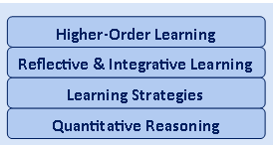
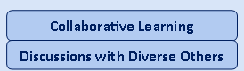
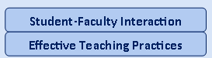
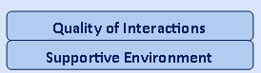
NSSE Engagement Indicators
Engagement Indicators
Engagement Themes
Academic Challenge
Learning with Peers
Experiences with Faculty
Student – Faculty Interaction
Campus Environment
Notes:
7

Slide 8
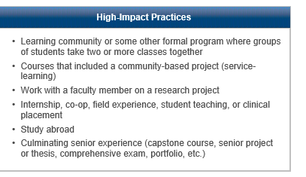
What are HIPS?
HIPS – High Impact Best Practices
(HIPs) share several traits:
They demand considerable time and effort, facilitate learning outside of the classroom, require meaningful interactions with faculty and students, encourage collaboration with diverse others, and provide frequent and substantive feedback
Kuh, G. D. (2008). High-impact educational practices: What they are, who has access to them, and why they matter.
Washington, DC: Association of American Colleges and Universities.

Slide 9
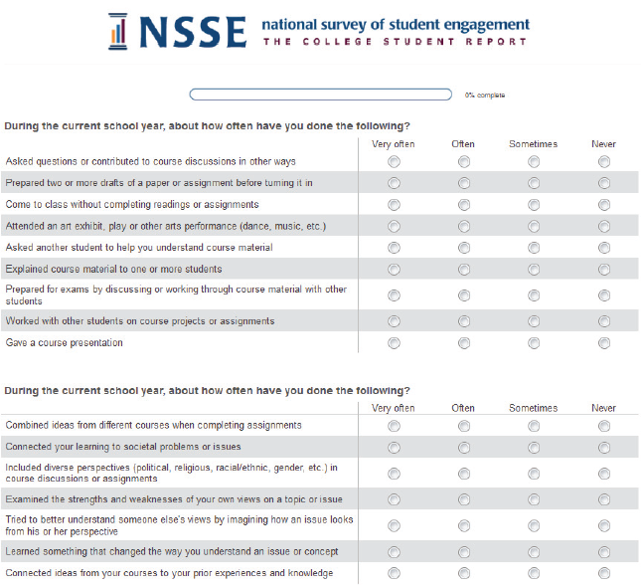
Survey Administration
Census-administered or randomly sampled first-year students & seniors
Mobile-optimized survey
Spring administration
Multiple follow-ups to increase response rates
Topical Modules provide option to delve deeper into the student experience
Consortium participation enables addition of custom questions
Notes:
The Center for Survey Research at Indiana University helps NSSE administer the survey in the field. See: csr.indiana.edu for more information.
NSSE survey design:
Relatively short survey
Items directly related to college outcomes
Administered to first-year and senior students at 4-year institutions
Administered directly by a credible third-party survey organization

Slide 10
WVU specific survey
Comparisons –
1. Big 12
2. Carnegie Peers
Use of topical models – 1. Academic Advising
2. Civic Engagement

Slide 11
Survey Participation 2019 Count
2019 (FY 908, 15%) (SR 628, 12%)
2013
2010
2007
2003 included the FSSE
Response Rate is low :
Big 12 and Carnegie comparison = (average for our size)
21% Freshmen and 20% Seniors

Slide 12
Demographics
WVU Demographics 2019
Asian 4.4%
Black 4.4 %
Hispanic 4.2%
Pacific Island 0.1%
Two or more 3.8%

Slide 13
Overall Engagement highlights First Year
Highest performing questions (Big 12)
Lowest performing questions (Big 12)
At least some courses included a community based practices (HIP) (+9) (+4 in 2013)
Assigned more than 50 pages of writing (+7)
Talked about career plans with faculty (+3)
Inst: used examples or illustrations (+2)
Worked with a faculty member or research (+1)
Spent more than 10 hrs per week on assigned reading (-6)
Inst: Emphasized using learning support services (-6)
Extent to which courses challenged you to do best (-7)
Spent more than 15 hrs per week preparing for class (-7)
Inst: Provided prompt and detailed feedback (-7)

Slide 14
Overall Engagement highlights Senior
Highest performing questions (Big 12)
Lowest performing questions (Big 12)
Completed a culminating senior experience (HIP) (+21)
At least some courses included community-based practices (HIP)(+12) (not highest in 2013)
Participated in an intern, co-op, field exp…. (HIP) (+9)
Worked with a faculty member or research (HIP) (+7)
Inst. Providing support for your overall (+6)
Examined the strengths and weaknesses of your own view… (-5)
Quality of interactions with Student service staff (-6)
Participated in a study abroad (HIP) (-7)
Spent more than 15 hrs per week preparing for class (-7)
Spent more than 10 hours per week on assigned reading (-10)

Slide 15
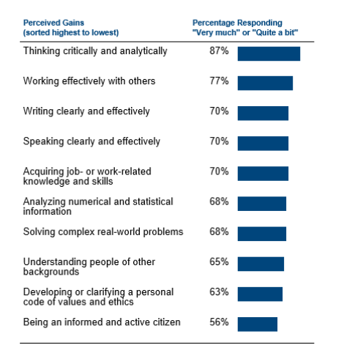

Slide 16
HIPs First-Year

Slide 17
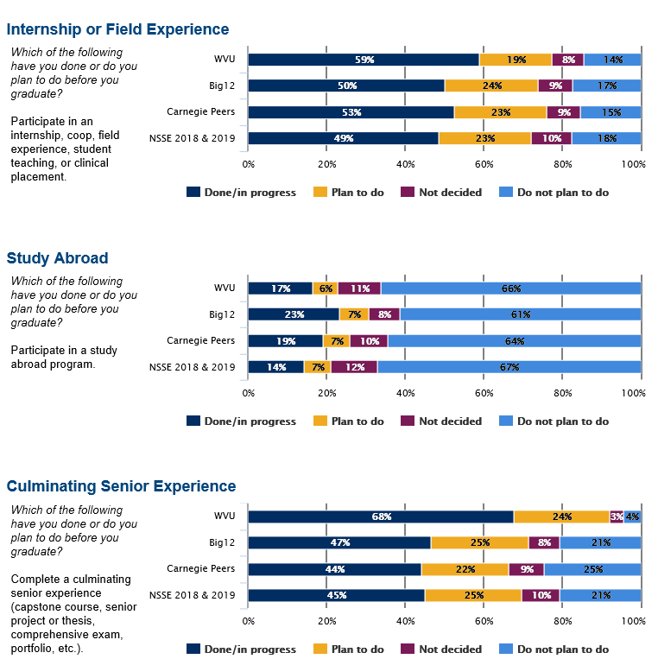
HIPs Seniors

Slide 18
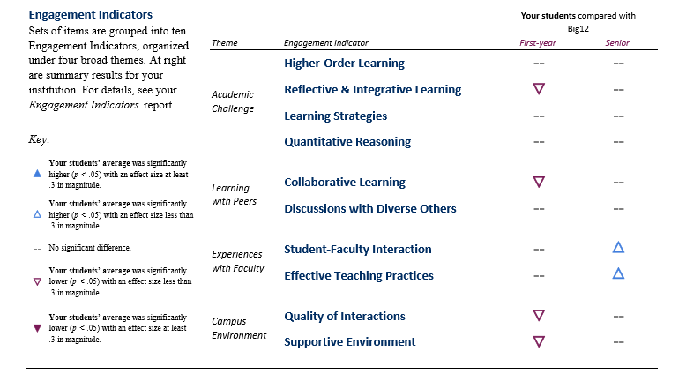
Engagement Indicators

Slide 19
Student Engagement Components
Time and effort students devote to activities shown in research to promote desired educational outcomes (Kuh, 2001, 2009)
Includes two key components:
Time and efforts devoted to effective educational practices
Institutional resources and support to provide effective educational practices
The second component represents an area where student life professionals can be particularly influential

Slide 20
Student Life can have an impact!
At high-performing colleges and universities, student affairs (life) staff collaborate with others to periodically collect and review data about the effectiveness of policies and practices…
(Kuh, Kinzie, Schuh, Whitt & Associates, 2010)
SL supports/or can support each area of HIPs and EIs
NSSE results provide indicators of educational quality – what matters to student success
View student engagement results as an opportunity to collaborate with other units to address campus concerns

Slide 21
Example of Data Use: Supportive Environment and Retention
CALIFORNIA STATE UNIVERSITY, SAN BERNADINO
Finding:
Campus living environment affects graduation and retention rates, as do student characteristics.
Action:
NSSE data used to determine which campus housing practices have the most impact on student learning and success. NSSE also gives insight into populations of students who face unique challenges that other surveys may not capture.
Notes:
This slide presents an example of how a NSSE-participating institution is already using its NSSE, BCSSE, and or FSSE data.
NSSE recommends creating your own slides and action items for your college or university.

Slide 22
Example of Data Use: Foster Collaboration and Focus
BIOLA UNIVERSITY
Finding:
Early results showed lower NSSE scores on an Engagement Indicator than desired.
Action:
Additional analyses were conducted and results disaggregated by student characteristics. Institution offered additional training on classroom behaviors.
Notes:
This slide presents an example of how a NSSE-participating institution is already using its NSSE, BCSSE, and or FSSE data.
NSSE recommends creating your own slides and action items for your college or university.

Slide 23
Example of Data Use: Engaging Support Units
California State University
Finding:
Learn that students spend more hours working for pay than do students at similar institutions.
Action:
Guide campus conversations on how to best support these students.
Notes:
This slide presents an example of how a NSSE-participating institution is already using its NSSE, BCSSE, and or FSSE data.
NSSE recommends creating your own slides and action items for your college or university.

Slide 24
Example of Data Use: Enhance Diversity Initiatives
Bucknell University
Finding:
Looked at responses by racial and ethnic group and compared HIPs and EIs.
Action:
Made significant changes to both Orientation Assistants and Resident Advisors to include new topics and offices focused on diversity and inclusion.
Notes:
This slide presents an example of how a NSSE-participating institution is already using its NSSE, BCSSE, and or FSSE data.
NSSE recommends creating your own slides and action items for your college or university.

Slide 25
Questions of interest at WVU
Are we meeting our expectations for a supportive campus environment?
How frequently do our students interact with faculty outside of the classroom? Dos this match out claims?
Are first-year students who withdraw from the institution different in terms of engagement than students who are retained?
What impact does our learning communities have on participants? By demographics?
To what extent are seniors experiencing an enriched education - do we pull programming through to senior year or focus predominately on first year?

Slide 26
If you would like to log in and view all the data, please email me and I will set up your account.
Thank you

