Slide 1

Wellbeing Data and Trends
February 2020

Slide 2
Top Academic Impediments* according to NCHA Survey Data
 | WVU | National | Iowa State | Kansas State | OK State | KU | UT Austin
First | Stress | Stress | Stress | Stress | Stress | Stress | Stress
Second | Anxiety | Anxiety | Anxiety | Anxiety | Anxiety | Anxiety | Sleep Difficulties
Third | Sleep Difficulties | Sleep Difficulties | Sleep Difficulties | Sleep Difficulties | Sleep Difficulties | Sleep Difficulties | Anxiety
Fourth | Depression | Depression | Depression | Cold/Flu/ Sore Throat | Depression | Depression | Depression
Fifth | Cold/Flu/ Sore Throat | Work | Work | Work | Work | (Tie) Work & Cold/Flu/Sore Throat | Participation in extracurricular activities
*Received a lower grade on an exam, or an important project; received a lower grade in the course; received an incomplete or dropped the course; or experienced a significant disruption in thesis, dissertation, research, or practicum work.
Notes:
Since stress is our top academic impediment, providing education on Stress Management is paramount. This includes health communication campaigns, workshops, large scale events (i.e. ChillFEST, and Fresh Check Day), and smaller tabling events in the residence halls.
An issue at present is that we do not have a professional staff member that is solely dedicated to this area of wellbeing. This limits our scope of how we are able to address the problem. If provided with more resources, we could be proactive in how we talk about stress and emotional & mental health, thus negating some harmful behaviors.

Slide 3
Mental Health
Students reported experiencing the following within the last 12 months:
 | WVU | National | Iowa State | Kansas State | OK State | KU | UT Austin
Felt things were hopeless | 52.2 | 55.9 | 52.4 | 50.8 | 48.1 | 52.6 | 51.8
Felt overwhelmed by all you had to do | 88.2 | 87.4 | 89.4 | 85.6 | 86.3 | 87.2 | 86.0
Felt exhausted (not from physical activity) | 85.5 | 84.7 | 85.2 | 83.7 | 83.1 | 83.5 | 85.0
Felt very lonely | 62.8 | 65.6 | 67.2 | 62.1 | 59.8 | 63.8 | 63.3
Felt very sad | 69.9 | 70.8 | 68.0 | 65.5 | 66.4 | 69.9 | 67.4
Felt so depressed it was difficult to function | 41.7 | 45.1 | 41.1 | 40.5 | 36.0 | 39.1 | 37.9
Felt overwhelming anxiety | 64.5 | 65.7 | 62.8 | 60.6 | 60.0 | 65.9 | 57.6
Felt overwhelming anger | 38.8 | 43.3 | 39.6 | 44.6 | 41.6 | 40.5 | 39.0
Seriously considered suicide | 13.3 | 13.3 | 10.9 | 13.4 | 9.3 | 11.5 | 9.3
Attempted suicide | 1.6 | 2.0 | 0.8 | 1.6 | 1.8 | 1.1 | 1.8
Intentionally cut, burned, bruised, or otherwise injured yourself | 8.5 | 8.6 | 5.9 | 5.9 | 6.0 | 4.7 | 5.6

Slide 4
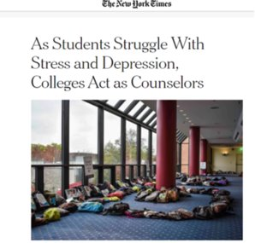
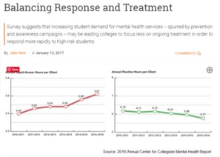
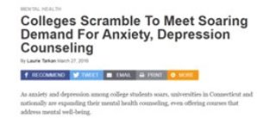
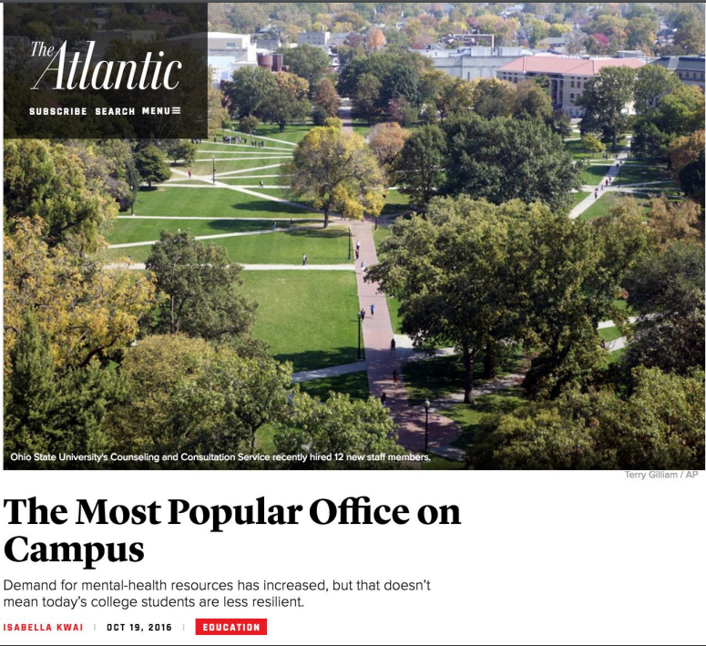
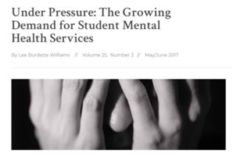
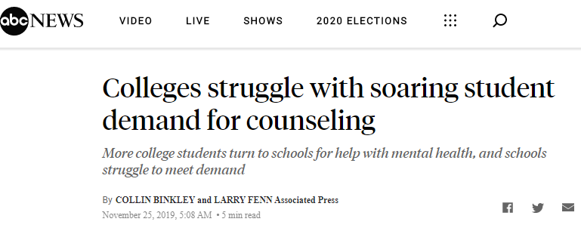


Slide 5
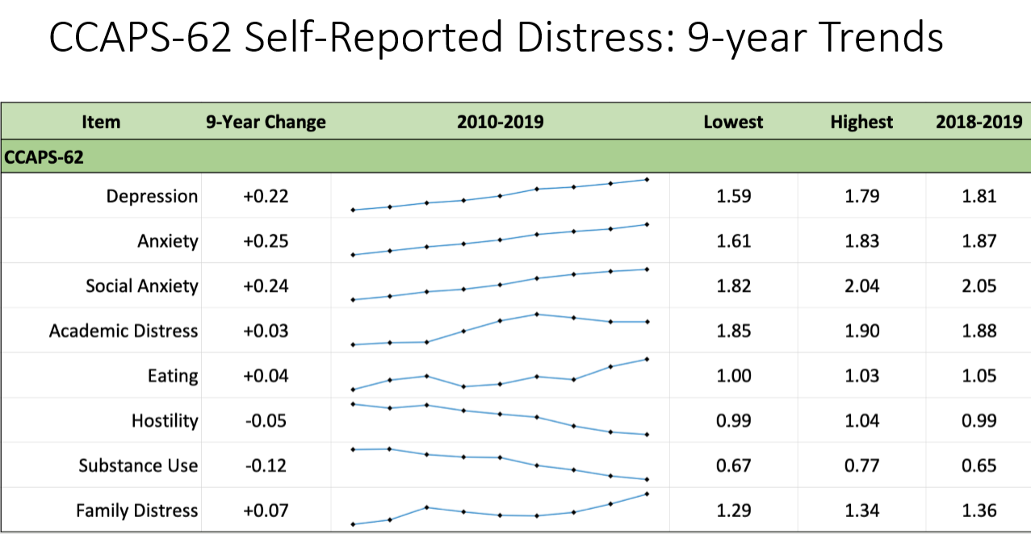
CCMH Data: 9-Year Trends

Slide 6
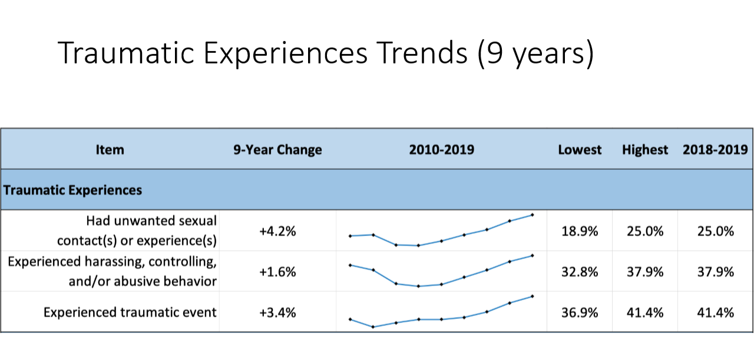
CCMH Data

Slide 7
College Mental Health Data
Across campuses:
27%: Anxiety significantly impacted their academic performance
19%: Depression significantly impacted their academic performance
33%: Stress significantly impact their academic performance
(NCHA, 2018)
From 2009-2015 national increase in enrollment was around 5-6 %, while increase in CC utilization was ~30-40 %
Anxiety and depression drive the increase in CC utilization, with other concerns remaining relatively stable
Lifetime prevalence of “threat-to-self” increased for seven years in a row
Ten percent of clients utilize about forty percent of sessions. (CCMH), 2017)
Notes:
I split this data up into other slides

Slide 8


Perfect Storm

Slide 9
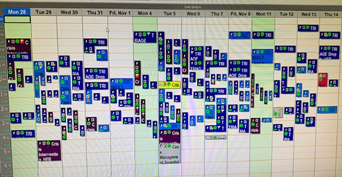
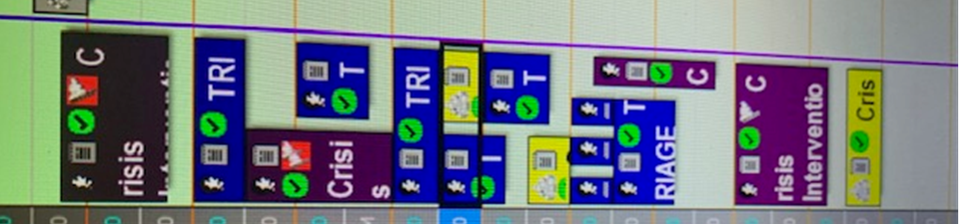
Our Data: New Normal
120% Crisis Intervention Appointments
(2008-2018)
107% in Drop-In Appointments
(2013-2018)

Slide 10
Crisis Intervention

Slide 11

College Mental Health Data
Carruth Center 2018-2019
54% of students reported having prior counseling
72% --depressive sxs
85% --anxiety sxs
52% --issues with sleep
29% --substance use issues
32% --previous/current self-injury
Suicide
  29% --current ideation
  33% --past ideation
  8% --reported past attempt

Slide 12
Fall 2019 Data
Number of students served: 1985 (7% of the student population)
Projected percentage for 2019-2020 academic year: 12%
Personal counseling: 2436 sessions, 508 students
Crisis intervention: 236 sessions
Workshops/Outreach: ~3000 students
Group therapy: 14 groups

Slide 13

Is the Sky Falling?!
Normalization Evidence of our success
  SAMHSA
  Peer programs in middle schools
  Pop culture
But yes… also lack of resiliency and reduced coping skills

Slide 14

It Takes a Village

Slide 15
Alcohol, Tobacco, and Marijuana Use - NCHA
Report of any use in the last 30 days:
 | WVU | National | Iowa State | Kansas State | OK State | KU | UT Austin
Cigarette | 6.9 | 6.4 | 3.8 | 9.1 | 9.4 | 7.9 | 9.6
E-Cigarette | 12.7 | 12.6 | 14.1 | 7.8 | 5.2 | 3.6 | 4.4
Hookah | 1.7 | 2.1 | 2.0 | 2.3 | 3.5 | 2.5 | 4.3
Alcohol | 68.8 | 58.4 | 66.7 | 67.9 | 65.0 | 69.2 | 68.7
Marijuana | 19.7 | 22.1 | 14.5 | 13.0 | 11.7 | 16.9 | 19.9
Summary: All Big 12 schools for which data is available show higher use of alcohol than the national sample, with WVU nearly 10% above that number.
WELLWVU has recently focused more on cannabis education – this includes utilizing Screen U, and hosting a panel discussion event in April (which will be replicated this year). Discussion of a larger health communication campaign is also taking place.

Slide 16
Alcohol Use, continued - NCHA
Reported number of drinks consumed the last time students “partied” or socialized (only students reporting one or more drinks were included):
 | WVU | National | Iowa State | Kansas State | OK State | KU | UT Austin
4 or fewer | 55.1 | 65.2 | 59.6 | 60.9 | 62.1 | 59.6 | 60.4
5 | 9.9 | 11.3 | 11.7 | 13.8 | 11.5 | 12.6 | 12.9
6 | 9.1 | 7.9 | 7.1 | 4.4 | 8.5 | 7.1 | 8.6
7 or More | 25.9 | 15.6 | 21.6 | 20.9 | 17.9 | 20.7 | 18.2
Mean | 5.1 | 4.19 | 4.53 | 4.59 | 4.42 | 4.75 | 4.49
Summary: WVU reported riskier substance behaviors than national sample and other Big 12 schools. Of major concern is the percentage of students who reported drinking 7 or more drinks in one sitting.

Slide 17
Alcohol Use, continued – EVERFI (Part II) [n ~ 3000]
How important to you is each of the following reasons for drinking alcoholic beverages?
 | Very Unimportant | Unimportant | Somewhat Unimportant | Neutral | Somewhat Important | Important | Very Important
To relieve stress | 31% | 15% | 12% | 18% | 12% | 6% | 4%
To have a good time with your friends | 9% | 5% | 9% | 21% | 20% | 20% | 17%
Feel happy | 32% | 13% | 11% | 19% | 13% | 7% | 5%
To get drunk | 22% | 11% | 11% | 21% | 16% | 10% | 9%
Feel more confident or sure of yourself | 36% | 12% | 11% | 17% | 12% | 8% | 5%
To celebrate | 9% | 5% | 8% | 23% | 23% | 20% | 12%
To decrease inhibitions | 44% | 17% | 11% | 18% | 6% | 3% | 2%
According to WVU’s 2019-2020 EVERFI data, WVU students under the age of 21 appear to be using alcohol to largely celebrate and have a good time with their friends.

Slide 18
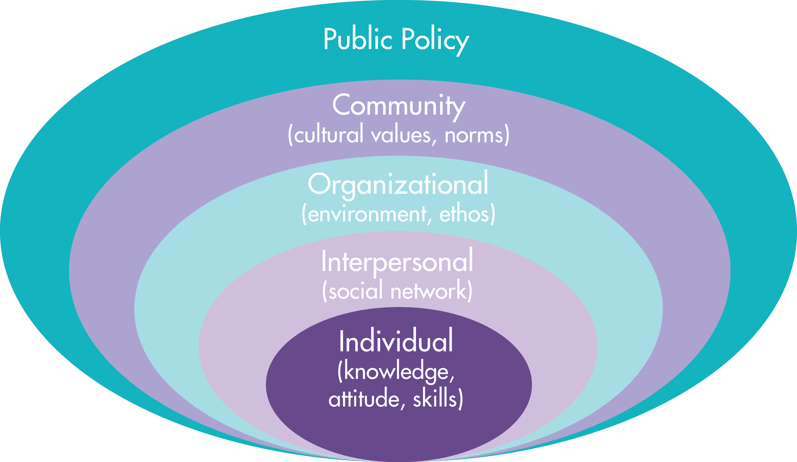
Current AE efforts of WELLWVU, organized by Socioecological model
Community Level:
Social Marketing Campaigns
EVERFI
AOD Coalition Work
Interpersonal Level:
EVERFI
TIPS training
Bartender School (standard drink size education)
WELLWVU Workshops
Standard
Individual Level:
EVERFI
Screen U
ECheckUpToGo
Bartender School
Hydration Stations
Organizational Level:
21st birthday emails – currently revamping
4x3
We strive to make sure that all interventions come from the College Alcohol Intervention Matrix (AIM). For more impact and longer lasting change, efforts should be made at the organizational, community, and policy level.
Notes:
AE = Alcohol Education

Slide 19
WELLWVU’s Program Planning Model
All programming at WellWVU is developed using the latest health promotion program planning models and is driven by research and theory. To standardize the planning process, a program summary form has been implemented to guide the planning and evaluation of every program. This form, which is based on the PRECEDE/PROCEED and Intervention Mapping models, includes basic event details, grounded theory and research, goals and objectives, and plans for action and evaluation.
Every effort is made to ground programming in health promotion theory and promising research in the field. All programs align with the Healthy Campus 2020/2030 objectives and current WVU NCHA data. Reaching out to other university health promotion departments to share programming ideas and resources is encouraged. Following the implementation of every program, the Program Reflection Worksheet should be completed, detailing how well objectives were met in addition to providing a process evaluation and reflection.

Slide 20
Other Drug Use- NCHA
Percent of college students who reported using prescription drugs that were not prescribed to them within the last 12 months:
 | WVU | National | Iowa State | Kansas State | OK State | KU | UT Austin
Antidepressants | 2.9 | 3.4 | 3.2 | 2.9 | 3.0 | 3.6 | 2.5
Erectile Dysfunction Drugs | 1.0 | 0.9 | 0.5 | 0.3 | 0.7 | 0.0 | 0.6
Pain Killers | 3.7 | 4.2 | 3.2 | 3.2 | 5.2 | 4.3 | 3.8
Sedatives | 2.9 | 3.0 | 1.9 | 2.0 | 3.8 | 3.1 | 3.9
Stimulants | 4.6 | 5.9 | 5.0 | 6.2 | 7.8 | 7.9 | 7.2
Used one or more of the above | 11.4 | 11.4 | 9.7 | 10.4 | 12.5 | 14.2 | 12.3
Summary: WVU appears to be about even or even below the national average for prescription drug abuse. WELLWVU has made efforts in the past to educate on this topic, but efforts were halted as the materials were deemed too provocative.

Slide 21
Sexual Behavior - NCHA
Report of using a condom or other protective barrier with the last 30 days:
 | WVU | National | Iowa State | Kansas State | OK State | KU | UT Austin
Oral Sex | 1.7 | 5.2 | 3.1 | 2.0 | 4.4 | 3.2 | 6.4
Vaginal Sex | 41.4 | 43.4 | 50.3 | 42.2 | 49.9 | 46.2 | 51.4
Anal Sex | 25.9 | 25.3 | 27.8 | 19.4 | 27.1 | 18.4 | 27.9
Reported number of sexual partners in the past 12 months:
 | WVU | National | Iowa State | Kansas State | OK State | KU | UT Austin
None | 25.1 | 33.1 | 33.6 | 31.0 | 34.3 | 31.5 | 37.1
1 | 47.5 | 43.6 | 44.5 | 50.0 | 44.1 | 44.3 | 37.4
2 | 8.6 | 8.8 | 7.3 | 9.5 | 8.5 | 8.0 | 9.5
3 | 4.9 | 5.1 | 5.2 | 3.3 | 4.6 | 4.5 | 5.5
4 or more | 13.9 | 9.4 | 9.3 | 6.2 | 8.4 | 11.7 | 10.5

Slide 22
Sexual Behavior, continued - NCHA
Reported having oral, vaginal or anal sex in the last 30 days:
 | WVU | National | Iowa State | Kansas State | OK State | KU | UT Austin
Oral Sex | 50.6 | 43.3 | 40.3 | 42.3 | 40.6 | 47.9 | 43.6
Vaginal Sex | 55.0 | 47.1 | 43.4 | 47.4 | 46.4 | 51.7 | 41.6
Anal Sex | 7.2 | 5.7 | 3.8 | 4.6 | 5.5 | 5.8 | 5.9
Summary: Across the board, use of protective barriers during any type of sexual activity is low. And while barrier method usage is comparable to other Big 12 schools, WVU report higher activity rates than both the national and Big 12 samples. Number of sexual partners is also a concern - WVU students are less likely to remain abstinent and if condom use is also low, that means an increased risk for STIs and unintended pregnancy.
Our current efforts include the “Condom Caravan”, health communication campaigns, and smaller sexual health tabling events, usually by special request. Our resources are extraordinarily limited, since we must purchase all condoms. Condom distribution needs to be ramped up, and more sexual health educational content must be offered through events, workshops, and social media content.

Slide 23
Nutritional Health
Trends amongst students seeking support at WVU:
Skipping meals due to poor time management
Lack of Knowledge: Shopping and preparing food
Lack of proper caloric intake due to attempted weight loss
They are not understanding that they have to fuel their bodies well even if weight loss is the goal.
WVU Students Seeking Dietetic Consultation by Topic (2019)
Weight loss | Weight Gain | Food Allergies | Eating Disorders | Healthy Eating | Vegan
37.70% | 1% | 5.30% | 11.20% | 42.30% | 2.50%

